Slide 1
Retrieval Augmented Generation
Definition: A hybrid approach combining pre-trained models with a retrieval system.
Ideal Use Cases: When up-to-date or specific external knowledge is needed.
Data Considerations: Effectiveness depends on the quality and breadth of the database.
When it makes sense: RAG is a hybrid approach that combines a pre-trained language model with a retrieval system, which looks up relevant information from a database of texts to generate responses. It's ideal when you need the AI to provide up-to-date information, refer to specific documents, or incorporate external knowledge that isn't already in the pre-trained model.
Simple explanation: Think of RAG as having an expert who can quickly look up the most relevant books or articles to answer questions with the latest, most specific information. It’s like having a smart assistant that can access a library in seconds to support its answers.

Slide 2
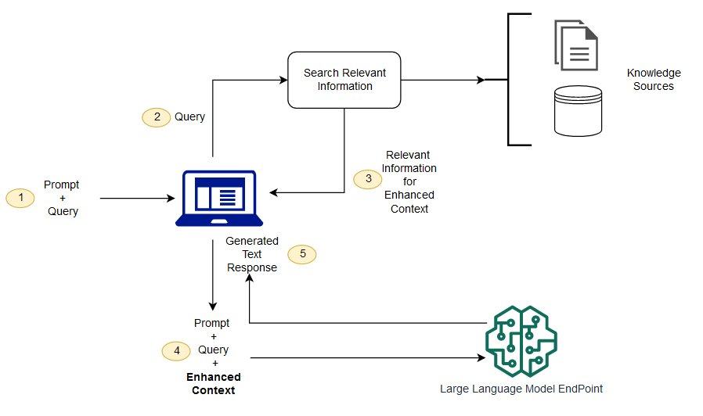
Retrieval Augmented Generation Architecture
AWS SageMaker Reference Architecture Illustration

Slide 3
Training or Fine-Tuning a Model
Definition: Customizing pre-trained models for specific tasks or domains.
Ideal Use Cases: When specific expertise or organizational alignment is required.
Data Considerations: Requires sufficient domain-specific data; limited data can hinder performance improvement.
When it makes sense: This approach is best when you have a specific task or domain of knowledge that the general AI model isn't well-versed in, or when you want to tailor the model’s responses to fit your organization’s tone, style, or guidelines.
Simple explanation: Fine-tuning a model is akin to giving a generalist a crash course in a particular subject area to align their answers with your company’s specific needs.

Slide 4
Using a General AI Foundation Model
Definition: Versatile models trained on vast datasets for a broad range of tasks.
Ideal Use Cases: General applications without the need for specialized knowledge.
Data Considerations: Generally not data-dependent for initial use but may lack specialized knowledge.
When it makes sense: This is suitable for a wide range of tasks without the need for specialized knowledge. Foundation models are versatile and have been trained on vast amounts of data, making them capable of generating high-quality content across various topics.
Simple explanation: Imagine a highly educated generalist who’s read almost everything and can write about a wide range of topics competently. That’s your foundation model—ready to tackle many tasks right out of the box without needing much customization.

Slide 5
Building Your Own Foundation Model
Definition: Developing a bespoke model from scratch tailored to unique needs.
Ideal Use Cases: When existing models don’t meet specificity, privacy, or security requirements.
Data Considerations: Demands massive, diverse datasets; not feasible without substantial data resources.
When it makes sense: Building a custom foundation model is an option when your data is highly specialized, proprietary, or sensitive, or when existing models do not meet your privacy, security, or specificity requirements. It requires significant resources and expertise.
Simple explanation: Constructing your own foundation model is like training a new employee from scratch to become the perfect fit for your company, equipped with exclusive knowledge that outsiders don't have. It's a considerable investment but can offer unique advantages tailored to your specific needs.

